Slide 1
Quantum Computing Architectures (EE274) Lecture 10
Hiu-Yung Wong
feb. 25, 2025
hiuyung.wong@sjsu.edu, Office: ENG363
http://www.sjsu.edu/people/hiuyung.wong/index.html

Slide 2
Outline
Schroedinger Equation, Spin, and Quantum Gate
Spin Angular Momentum Operator
Rabi Oscillation

Slide 3
Schroedinger Equation
Chapter 4, Chapter 7, Chapter 8 of “Quantum Computing Architecture and Hardware for Engineers: Step by Step”

Slide 4
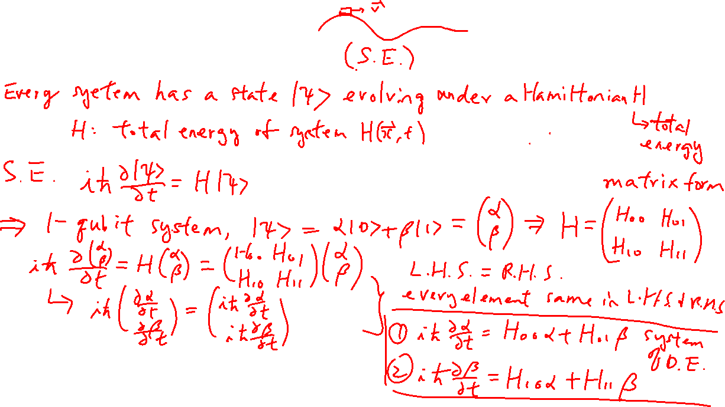
Schroedinger Equation
Learning outcomes: Understand SE is the governing equation and how to solve it

Slide 5
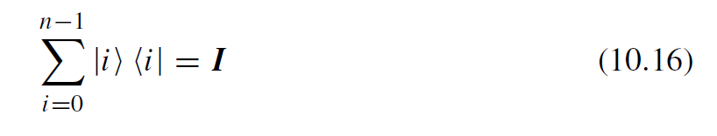
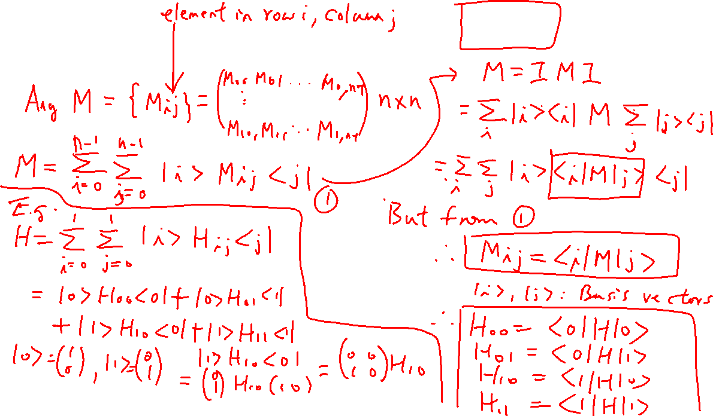
Finding Matrix Elements

Slide 6
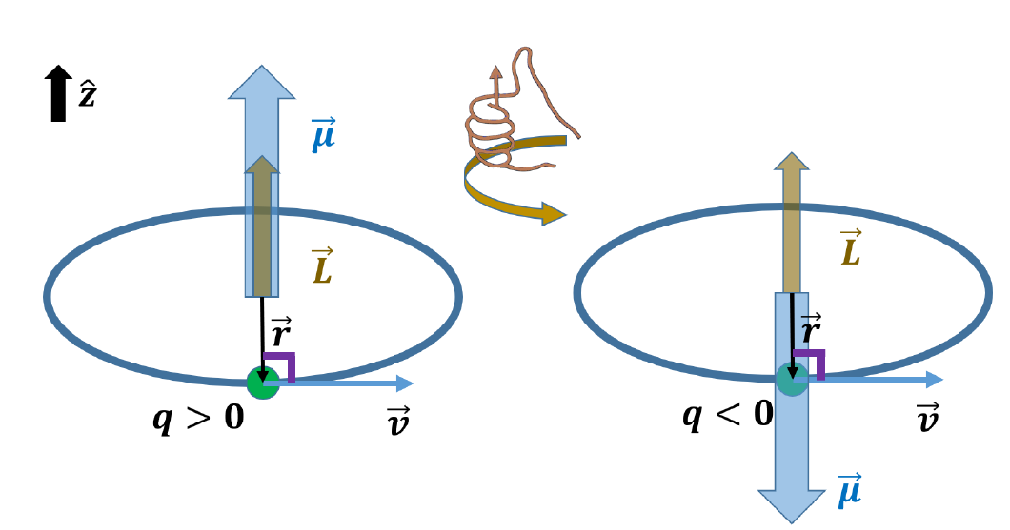
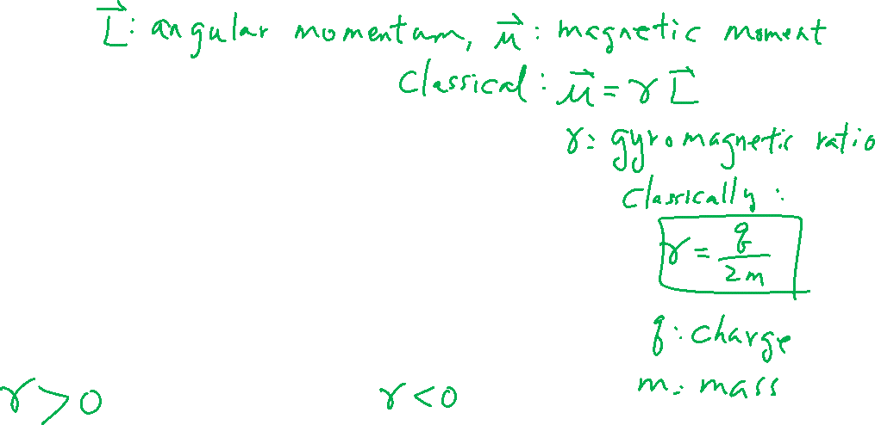
Classical Magnetic Moment

Slide 7
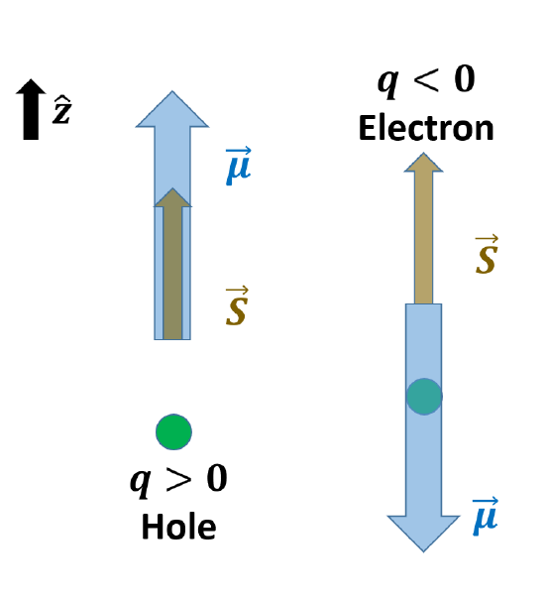
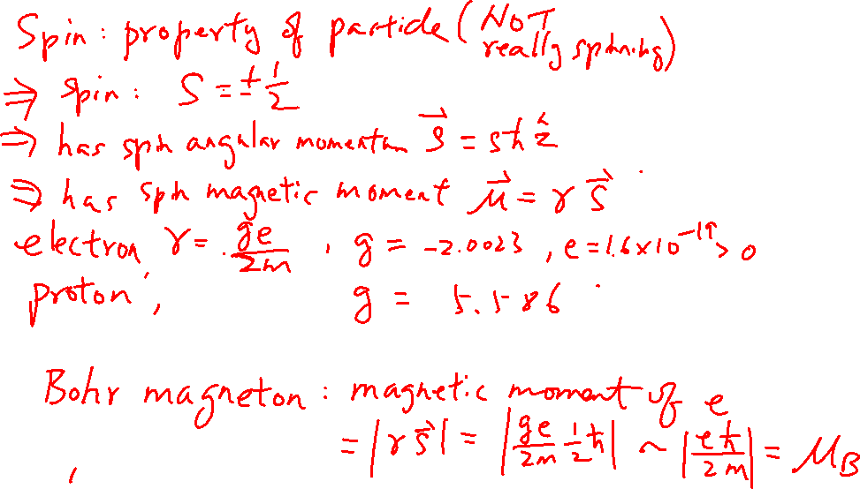
Spin and Magnetic Moment
Learning outcomes: How does the charge affect the direction of magnetic moment?

Slide 8
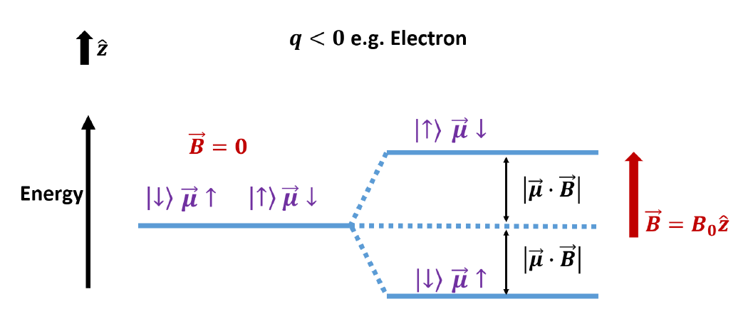
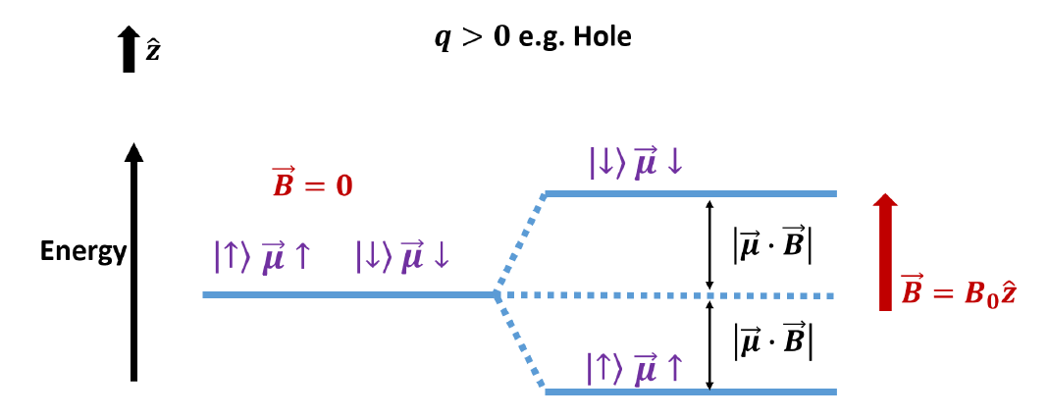
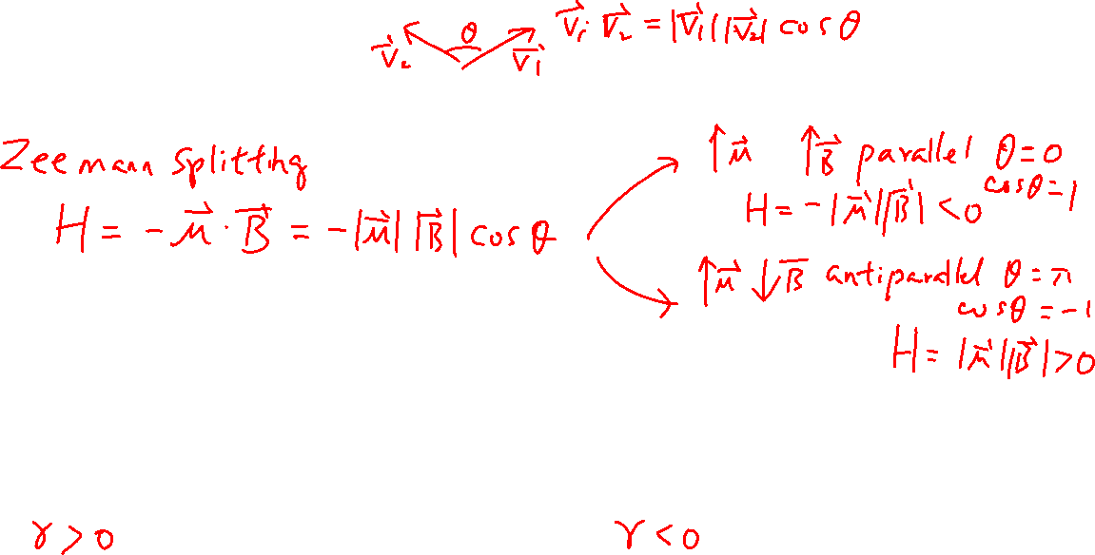
Spin in Magnetic Field
Learning outcomes: Understand the interaction Hamiltonian

Slide 9
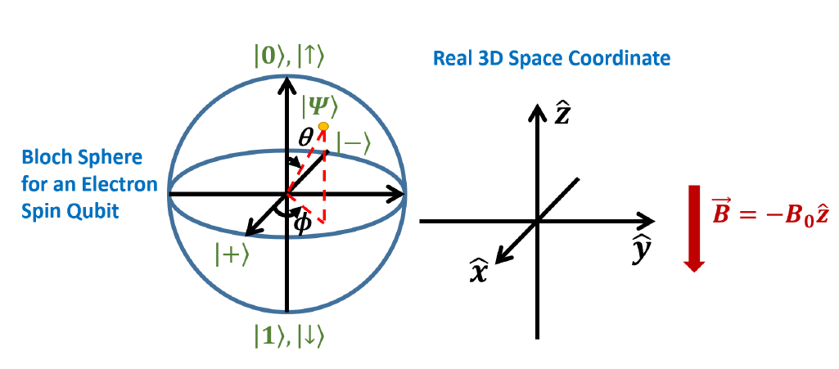
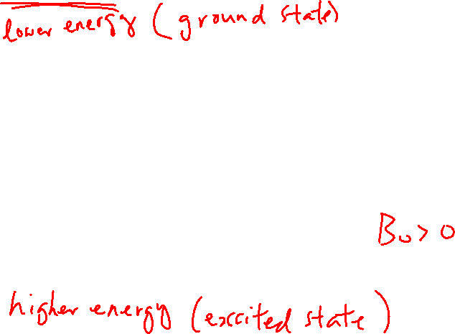
Bloch Sphere Representation of the Spin State (electron)
Learning outcomes: Relationship to the 3D space

Slide 10
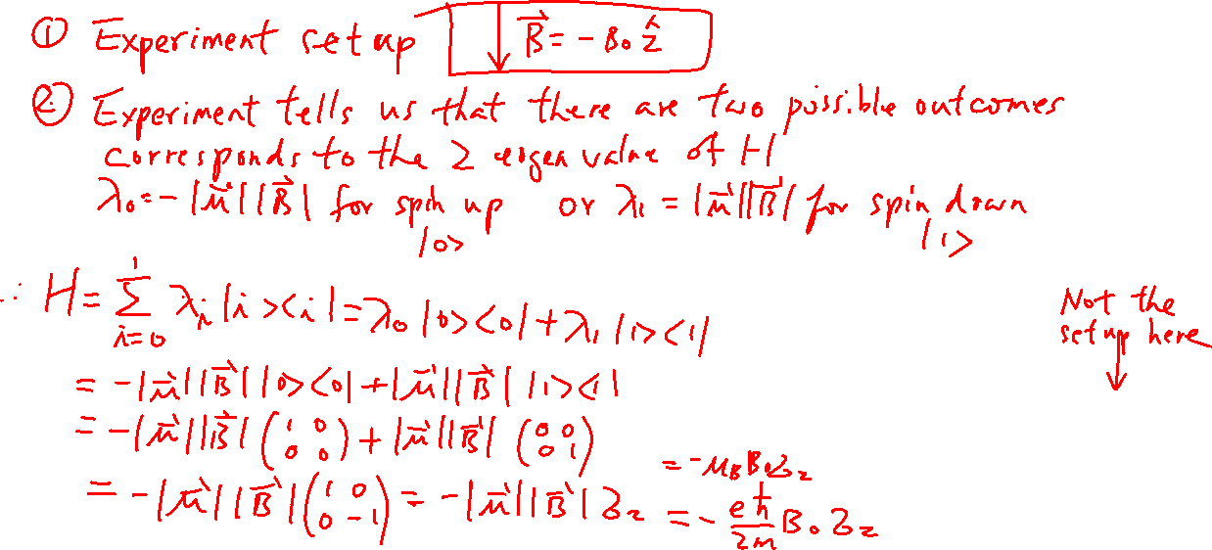
Construction of Hamiltonian
Learning outcomes: Understand the interaction Hamiltonian

Slide 11
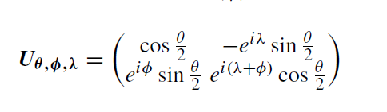
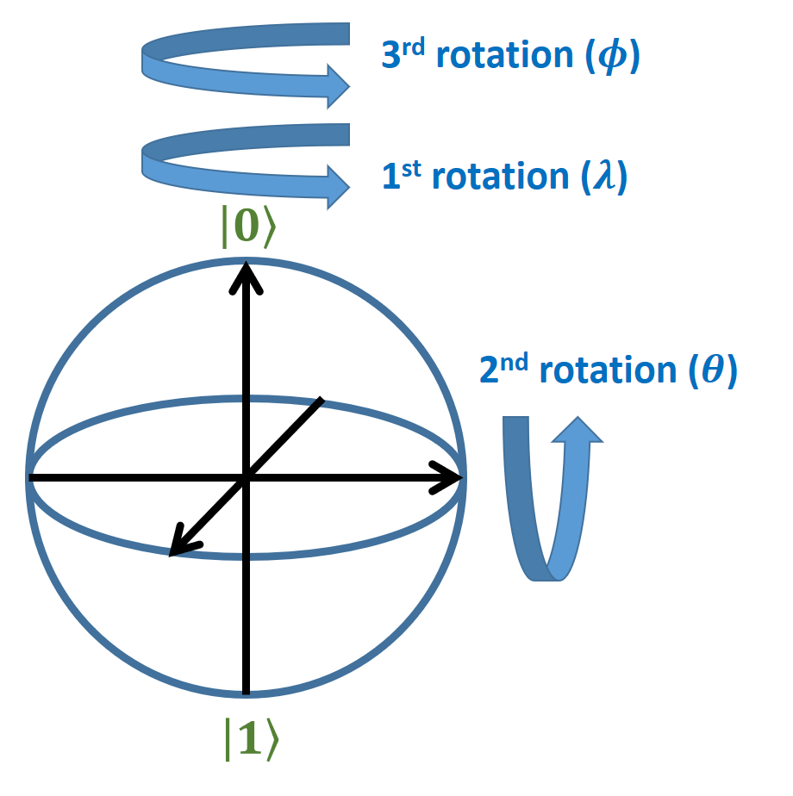
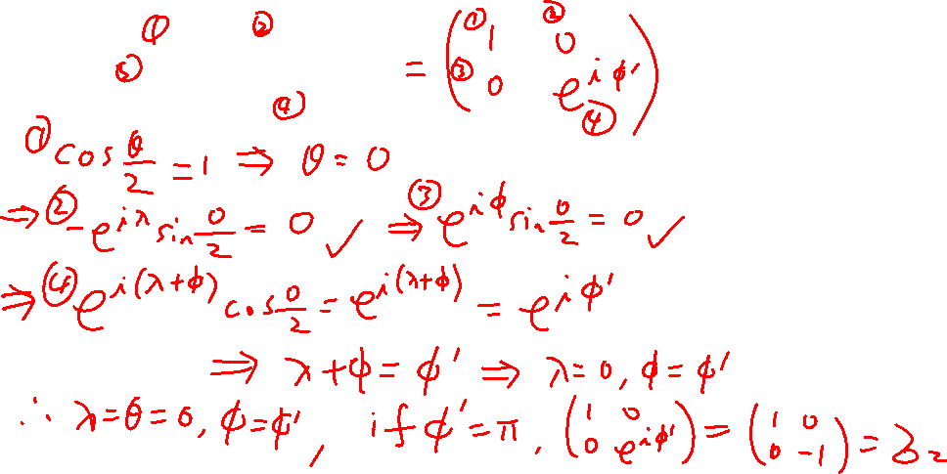
Construction of Z-gate (Phase Shift Gate)
Learning outcomes: Review the math of finding the rotations on Bloch sphere for a given gate.

